Slide 1
State of the State in TB Control
Jason Stout, MD, MHS
Wake County TB Medical Consultant
NC TB Medical Director
Division of Infectious Diseases, Duke University Medical Center

Slide 2
Disclosures-Funding
NIH (grant)
UpToDate (card author)

Slide 3
TB down the world around
Did COVID scare it away?
Everyone’s in lockdown
Public health in disarray
New short treatment in the bag
Until you see the big price tag.
Spending US resources on latent TB
Better to focus on global community

Slide 4
TB News for the Year
Large drop in US cases in 2020
New short-course regimen for active TB
High-tech tests for LTBI don’t meet predictions
Global interconnectedness highlighted

Slide 5
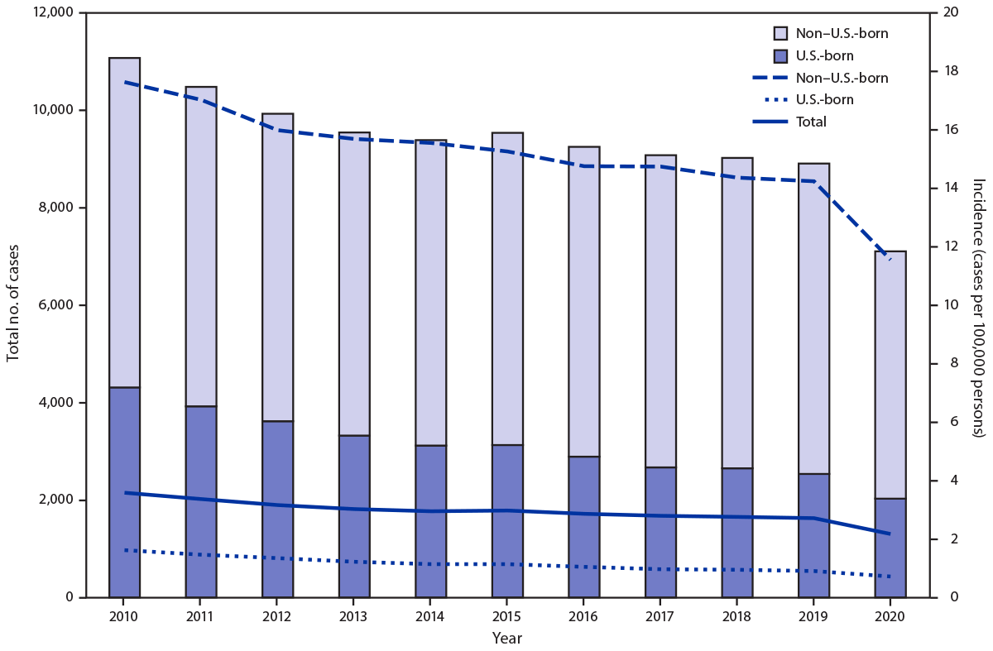
Big Drop in US TB
MMWR 2021; 70(12): 409

Slide 6
NC TB cases 1993-2020
# Cases
Year

Slide 7
Biomarkers for TB
TST and IGRAs are markers of immune exposure to M tuberculosis
  Don’t indicate whether live bacteria are present in the body
  Don’t distinguish between infection and disease
Poor positive predictive value for progression to active TB

Slide 8
Abubakar I et al., Lancet Inf Dis 2018; 18: 1077

Slide 9
Biomarkers for TB

Slide 10
What is TB Doing During Latency?
Most people who progress to active disease do so in first 1-2 years after infection
Some reactivate later
Is the TB “hiding in there?”

Slide 11
What is TB Doing During Latency?
Study of 24 pairs of patients with active TB and close contacts who subsequently reactivated with the same strain of TB
Patients recruited in Vitória, Brazil 2008-2013
Examined the mutation rate of M tuberculosis as a function of time to reactivation
Nature Communications 2020; 11: 4870

Slide 12
What is TB Doing During Latency?
Nature Communications 2020; 11: 4870

Slide 13
What is TB Doing During Latency?
Limited data, but suggests that there may be two phases of latent TB
  “Early latency” with relatively rapid replication (first 1-2 years after infection)
  “Late latency” with relatively slow replication (greater than 2 years after infection)
Nature Communications 2020; 11: 4870

Slide 14
Biomarkers for TB
One approach has examined profiles of mRNA expression in whole blood
  Presumably looking at inflammation in response to the infection
Another examines how white cells respond to stimulation with TB proteins
  Presumably an indirect measure of how much TB exposure (antigen burden) white cells are getting

Slide 15
Biomarkers for TB
Looked at adolescents in S Africa with different TB profiles:
  QFT negative
  Recent infection (2 negative QFT followed by 2 positive QFT, 6 mos apart)
  Remote infection (4 positive QFT 6 mos apart over 1.5 years)
  Progressors (developed TB disease)
  Nonprogressors (did not develop TB disease)
Am J Respir Crit Care Med 2021; 203: 1556

Slide 16
Biomarkers for TB
Used flow cytometry to examine two possible biomarkers:
  “Responder”-measurement of cells that expressed interferon gamma/TNF/CD3 after stimulation
  “Activation”-relative measurement of cells that expressed HLA-DR in “responder” cells vs. total T cells
Am J Respir Crit Care Med 2021; 203: 1556

Slide 17
“Responder” marker
Am J Respir Crit Care Med 2021; 203: 1556

Slide 18
“Activation” marker
Am J Respir Crit Care Med 2021; 203: 1556

Slide 19
“Activation” marker
Am J Respir Crit Care Med 2021; 203: 1556

Slide 20
Biomarkers for TB
Potential for new tests based on more sophisticated immunological assessment
Ideal tests would be able to accurately
  Predict who will progress to active TB
  Distinguish active from latent TB
Still not there…
Am J Respir Crit Care Med 2021; 203: 1556

Slide 21
Latent TB Biomarkers
TST and IGRAs are markers of immune exposure to M tuberculosis
Even in high-risk populations, a small proportion of patients with positive tests will go on to develop active TB
More specific tests are needed

Slide 22
Latent TB Biomarkers
RNA expression profiles have been studied as potentially more specific biomarkers
Single blood draw with examination of expression of certain genes (presumably in the white cells)
Pretty good ability to predict progression to active TB in the near term (1-2 years)

Slide 23
Scriba TJ et al, Lancet Infect Dis 2021; 21: 354

Slide 24
Scriba TJ et al, Lancet Infect Dis 2021; 21: 354

Slide 25
CORTIS
High-risk cohort!
  25/375 in RISK-11+/3HP group excluded due to prevalent TB (22/764 in RISK-11+/no 3HP, 14/1784 in RISK-11- group)
  24 study participants developed TB during followup
Over 80% of prevalent TB cases were asymptomatic
Scriba TJ et al, Lancet Infect Dis 2021; 21: 354

Slide 26
Scriba TJ et al, Lancet Infect Dis 2021; 21: 354

Slide 27
RISK-11 Not very good after 12 mos
Scriba TJ et al, Lancet Infect Dis 2021; 21: 354

Slide 28
Scriba TJ et al, Lancet Infect Dis 2021; 21: 354

Slide 29
CORTIS conclusions
Biomarker-based treatment not effective in high-incidence setting
The biomarker didn’t work very well
  Reasonable in symptomatic cases, but many were asymptomatic
Reinfection and lower than expected incident cases may have contributed
Scriba TJ et al, Lancet Infect Dis 2021; 21: 354

Slide 30
Video DOT Costs
Video DOT saved our bacon in 2020
Increasingly rolled out across the US
How are others doing?

Slide 31
Video DOT Costs
Study of VDOT compared with in-person DOT costs in three jurisdictions:
  New York City
  Rhode Island
  San Francisco, CA
Used both synchronous and asynchronous VDOT in NYC, only asynchronous in other two jurisdictions
Beeler Asay GR et al, Am J Public Health 2020; 110: 1696

Slide 32
Video DOT Costs
Beeler Asay GR et al, Am J Public Health 2020; 110: 1696

Slide 33
Video DOT Costs
New York City Rhode Island San Francisco
Beeler Asay GR et al, Am J Public Health 2020; 110: 1696

Slide 34
Video DOT Costs
Recorded VDOT platforms included eMocha and SureAdhere
Live VDOT done on Skype for Business
One site provided phones to patients
Incentives/enablers provided to clinic DOT patients
Beeler Asay GR et al, Am J Public Health 2020; 110: 1696

Slide 35
Video DOT Costs
Beeler Asay GR et al, Am J Public Health 2020; 110: 1696

Slide 36
Video DOT Costs
Rhode Island VDOT cost was greater than field DOT ($24.20/visit versus $21.43, respectively)
56% of recorded VDOT sessions were recorded outside of work hours (vs. only 5% of live VDOT sessions)
12% of patients reported technical problems with most recent VDOT dose, most of which were resolved immediately
Beeler Asay GR et al, Am J Public Health 2020; 110: 1696

Slide 37
Video DOT Conclusions
VDOT was cheaper in NYC and San Francisco than in-person DOT
Access to phones key; NYC loaned phones to patients
Convenience may be at least as importance as cost (not addressed by this study)

Slide 38
Preventing Congenital TB
NC has had two congenital TB cases over the past 5 years
Both cases were associated with fertility treatments
One baby died soon after birth; the other survived after a long hospital course but unclear long-term consequences

Slide 39
Preventing Congenital TB
Infertility is a common presentation of genitourinary TB in endemic countries
In one study, 19/140 (14%) of women presenting for IVF to a clinic in North India had TB as the underlying etiology
Conversely, TB is a very rare cause of infertility in the US
Singh N et al, Arch Gynecol Obstet 2008; 278: 325

Slide 40
Preventing Congenital TB
TB screening is not a routine part of the standard evaluation of infertile women in the US
It probably should be
Yale Fertility Center did a quality improvement project 1/2014-1/2017 to assess
Tal R et al, Am J Obstet Gynecol 2020; 223: 737.e1-10

Slide 44
TB and NTM
Nontuberculous mycobacteria are organisms that live in the environment
Emerging cause of both pulmonary and extrapulmonary disease
Look like TB on acid-fast smears so can cause diagnostic confusion

Slide 45
TB and NTM
NTM can be isolated from sputum of TB patients
Incidence varies widely across settings:
  Zambia: 0.2% (Chanda-Kapata et al.BMC Infect Dis 2015; 15: 500)
  Belgium: 1.4% (De Keukelire et al. Acta Clin Belg 2017; 72: 45)
  Tanzania: 5.6% (Hoza et al, BMC Res Notes 2016; 9: 109)
  Oregon: 14% (Kendall et al, Int J Tuberc Lung Dis 2010; 14: 654)

Slide 46
TB and NTM
Retrospective study in Taiwan 2005-2013
Used claims data from national health insurance system to estimate prevalence of NTM infection as well as TB-NTM coinfection
Lin CK et al, Medicine 2020; 99:52(e23775)

Slide 47
TB and NTM

Slide 48
TB and NTM
Lin CK et al, Medicine 2020; 99:52(e23775)

Slide 49
TB and NTM
Lin CK et al, Medicine 2020; 99:52(e23775)

Slide 50
TB and NTM
Overall 2.8% of TB patients were also infected with NTM
Coinfection higher with increasing age, male sex, and residence in an urban area
No data on management or impact on outcomes
Lin CK et al, Medicine 2020; 99:52(e23775)

Slide 51
We’re All Connected
TB in the US is primarily an imported disease
CDC has focused on testing and treatment for latent TB in foreign-born US residents
Is this the most effective strategy?

Slide 52
We’re All Connected
Model examined the impact of improving TB control in 5 countries:
  Mexico
  The Philippines
  India
  Vietnam
  China
Menzies NA et al, Am J Respir Crit Care Med 2020; 202: 1567

Slide 53
We’re All Connected
Menzies NA et al, Am J Respir Crit Care Med 2020; 202: 1567

Slide 54
We’re All Connected
Looked at 3 scenarios:
  Optimistic: 90% decline in TB incidence rates by 2035
  Current trend: Current trends in TB decline will continue
  Pessimistic: No change in TB incidence rates between 2020-2035
Menzies NA et al, Am J Respir Crit Care Med 2020; 202: 1567

Slide 55
We’re All Connected
Orange=optimistic scenario
Black=current trend
Green=no change from present
Menzies NA et al, Am J Respir Crit Care Med 2020; 202: 1567

Slide 56
We’re All Connected
Reducing TB incidence in these 5 countries by 90% 2020-2035 reduced TB incidence in the US by 49% during that time period
No reduction in TB incidence in those 5 countries resulted in essentially no change in US TB incidence
Estimated 23,626 US TB cases averted during this time period
Menzies NA et al, Am J Respir Crit Care Med 2020; 202: 1567

Slide 57
Conclusions
The state of the state is strong!
Despite COVID, US TB has carried on its critical mission
New challenges will demand novel solutions

